Slide 1
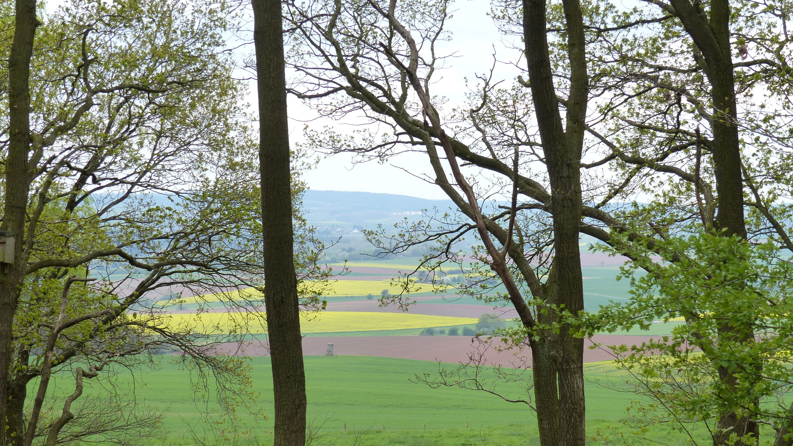
Class 8: Toward an Ecosystem Approach
Larry Swatuk
lswatuk@mta.ca

Slide 2
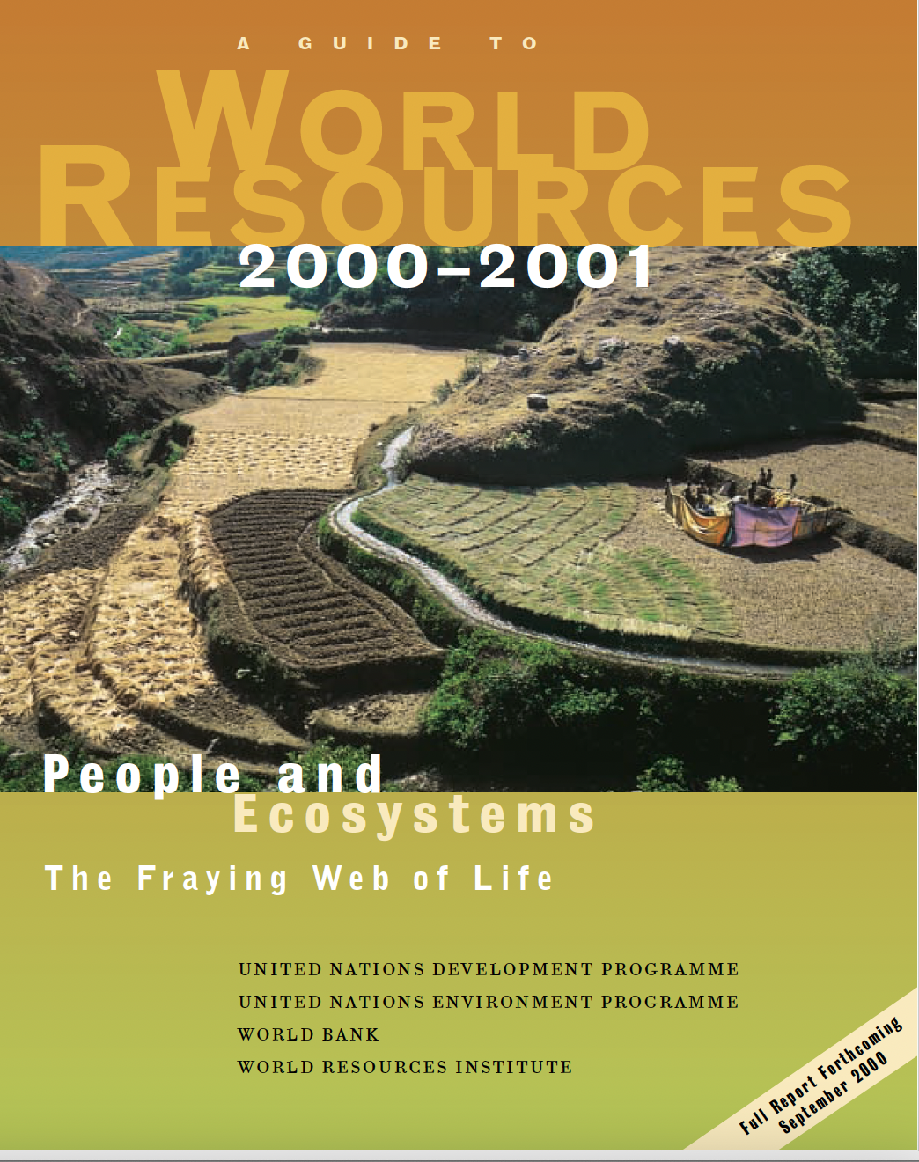
Ecosystem
A community of organisms occupying a given region within a biome, including the physical and chemical environment of that community and all the interactions among and between organisms and their environment

Slide 3
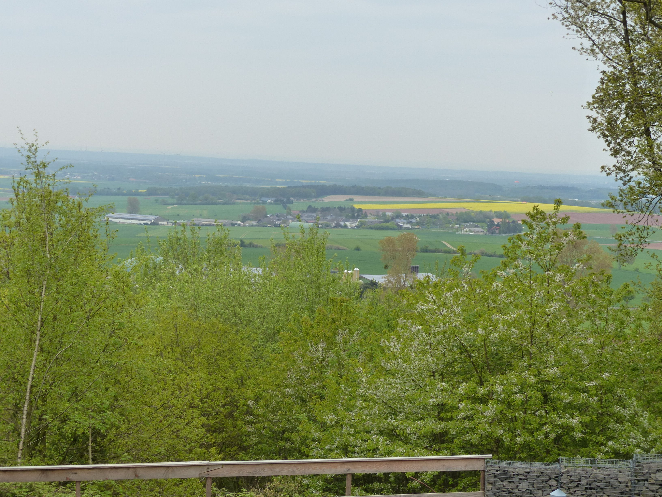
Ecosystems
Ecosystems sustain us. They are Earth’s primary producers, solar-powered factories that yield the most basic necessities – food, fiber, water.
Ecosystems also provide essential services – air and water purification, climate control, nutrient cycling, and soil production – services we can’t replace at any reasonable price.
-- World Resources 2000-01, p.8

Slide 4
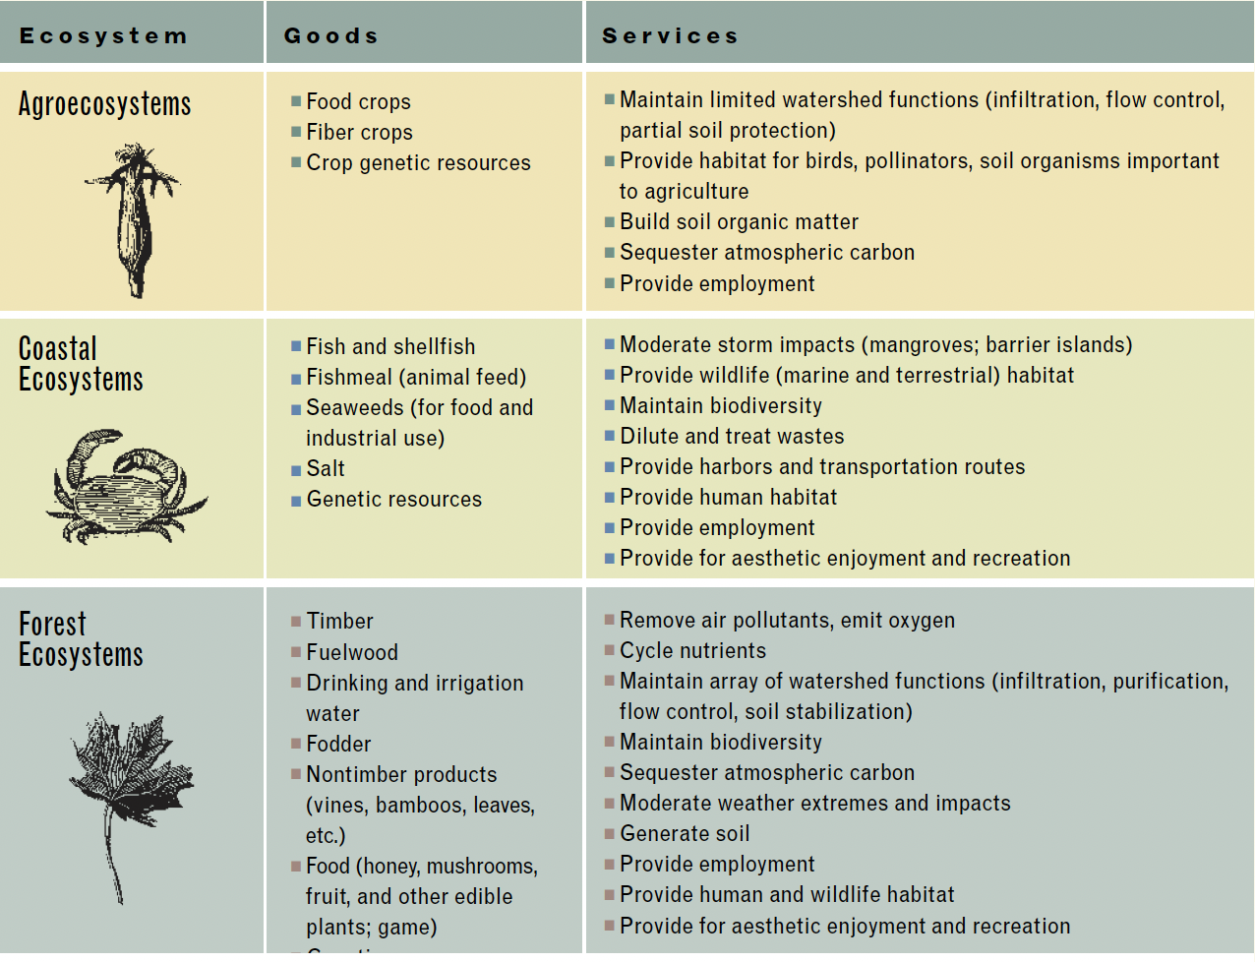

Slide 5
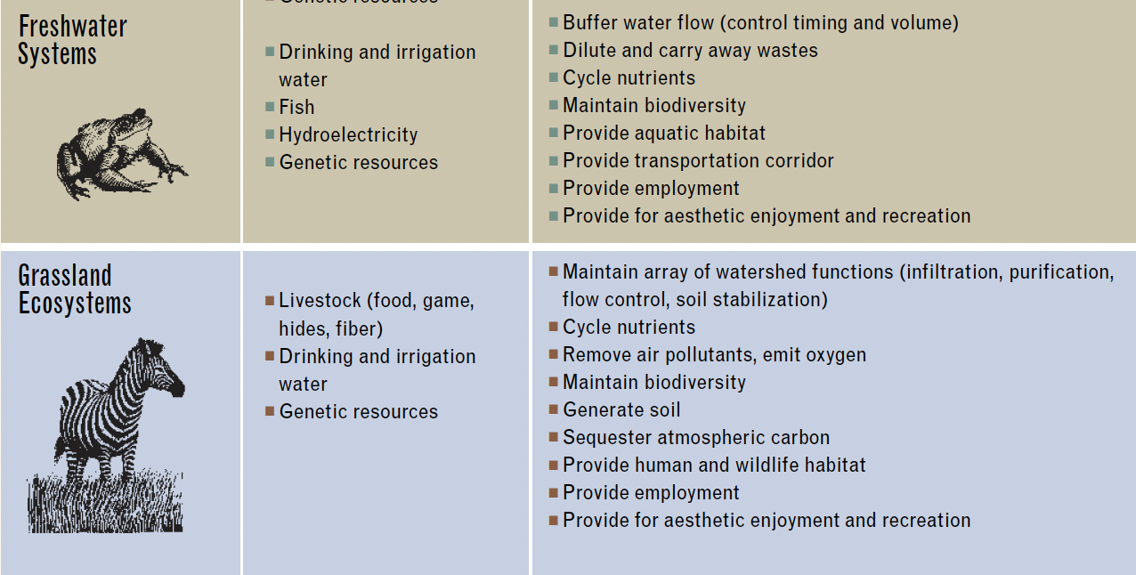

Slide 6
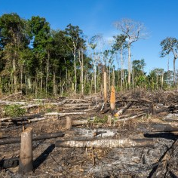
Ecosystem Degradation
75% of major marine fish stocks either depleted from overfishing or are being fished to their biological limit.
Logging and conversion have shrunk the world’s forest cover by as much as half, and roads, farms and residences are rapidly fragmenting what remains into smaller forest islands.
58% of coral reefs are potentially threatened by destructive fishing practices, tourist pressures and pollution
65% of the roughly 1.5 billion ha of cropland worldwide have experienced some degree of soil degradation.
Overpumping of groundwater by the world’s farmers exceeds natural recharge rates by at least 160 billion m3/year

Slide 7
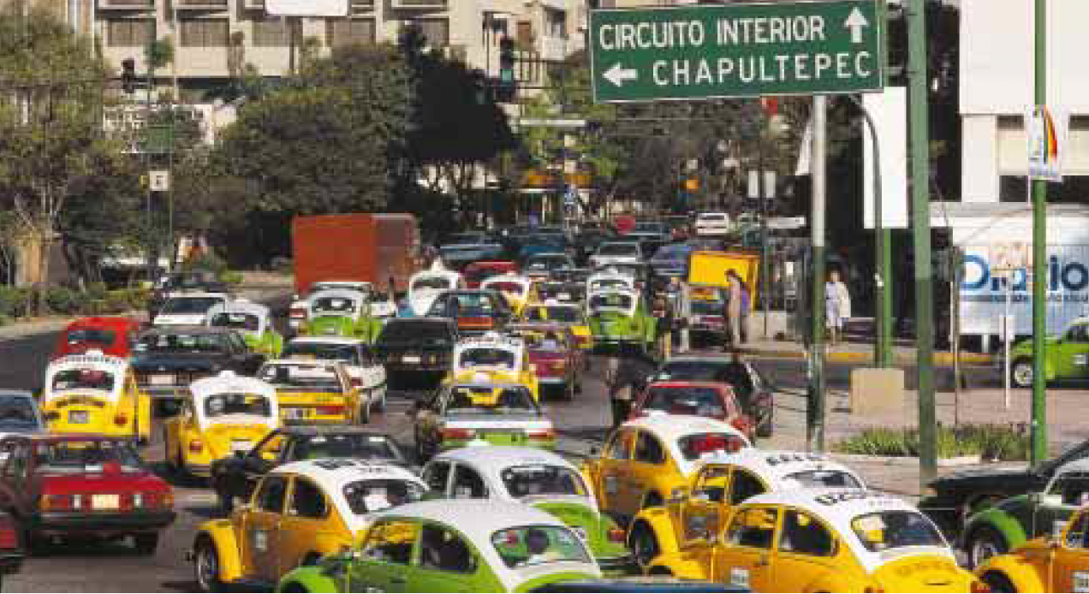
Principle pressures
Overuse
Conversion
Invasive species
Pollution
Climate change

Slide 8
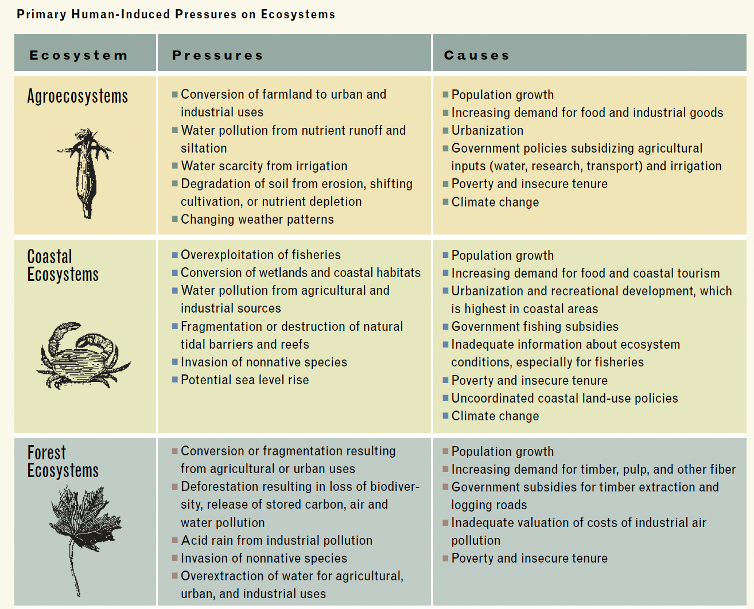

Slide 9
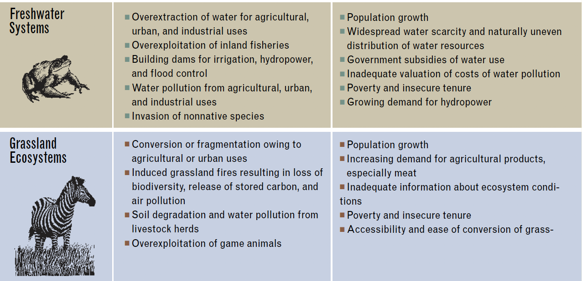

Slide 10
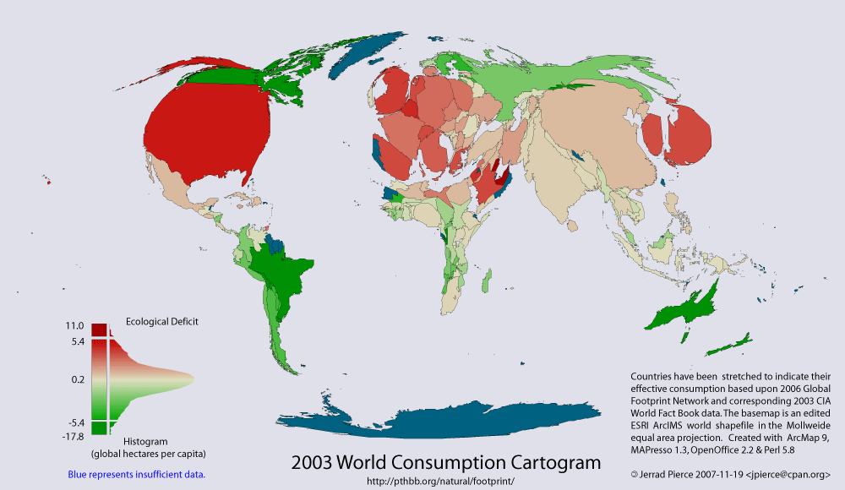

Slide 11

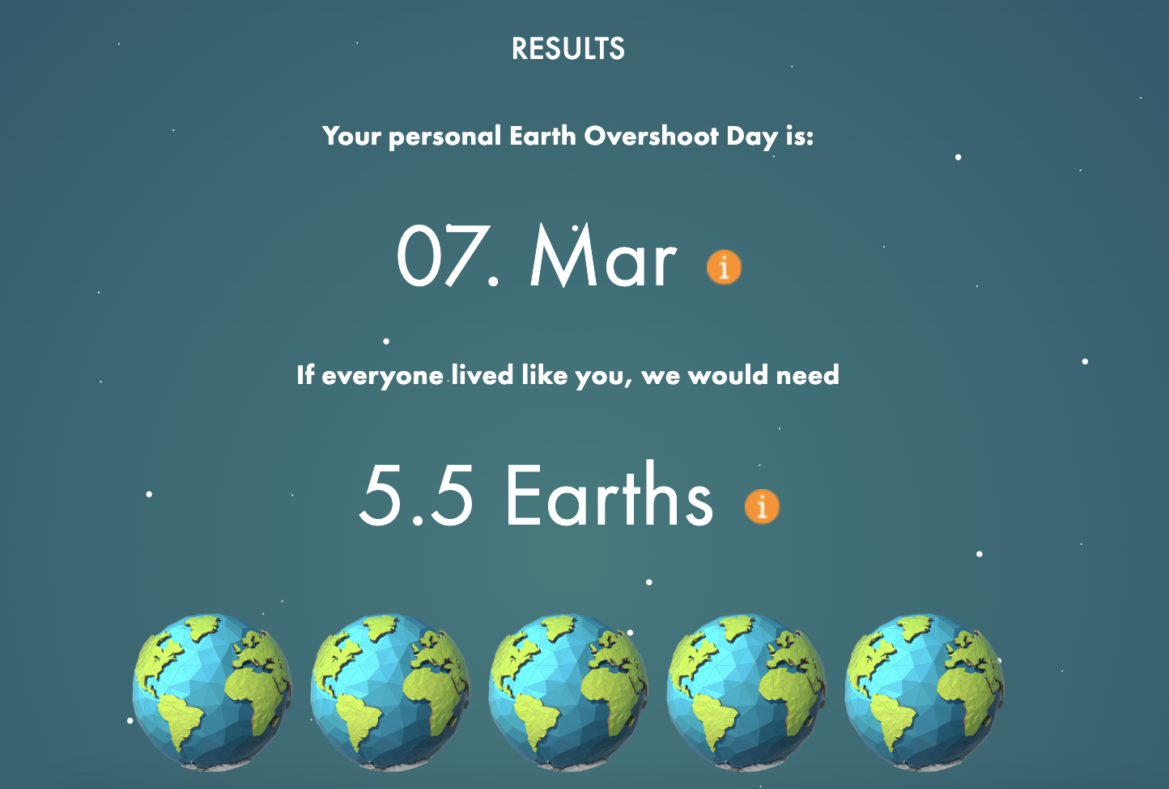
Global Footprint
https://www.footprintnetwork.org/

Slide 12
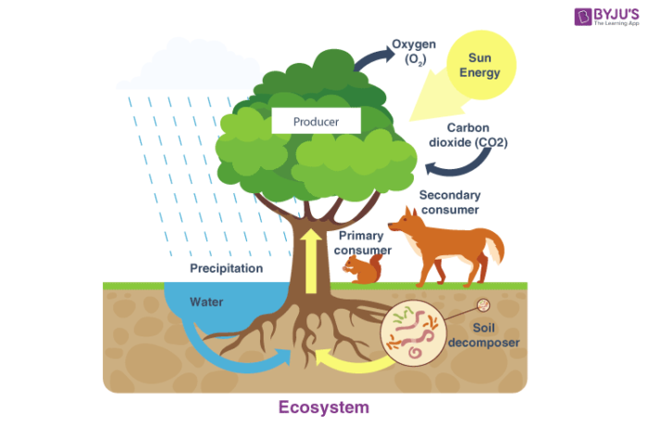
Ecosystem Based Management
Holistic management that takes into account the entire ecosystem and emphasizes biodiversity and ecosystem integrity, as opposed to focusing primarily or solely on a resource or resources, such as water or timber, within an ecosystem.

Slide 13
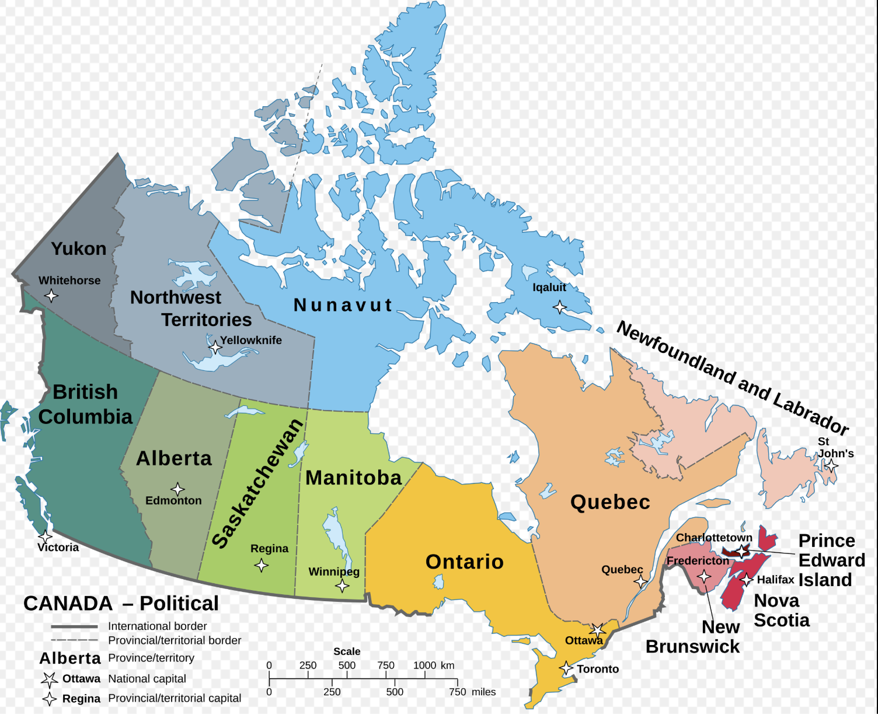

Slide 14
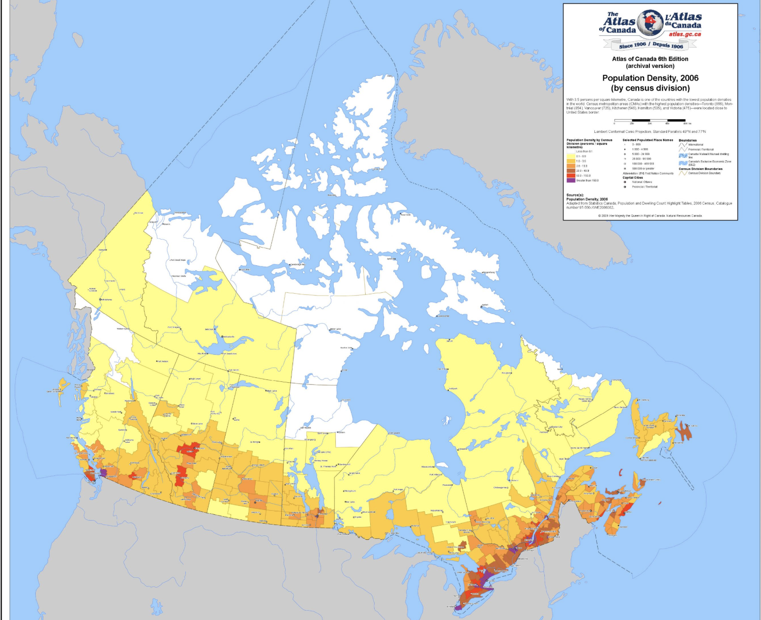

Slide 15
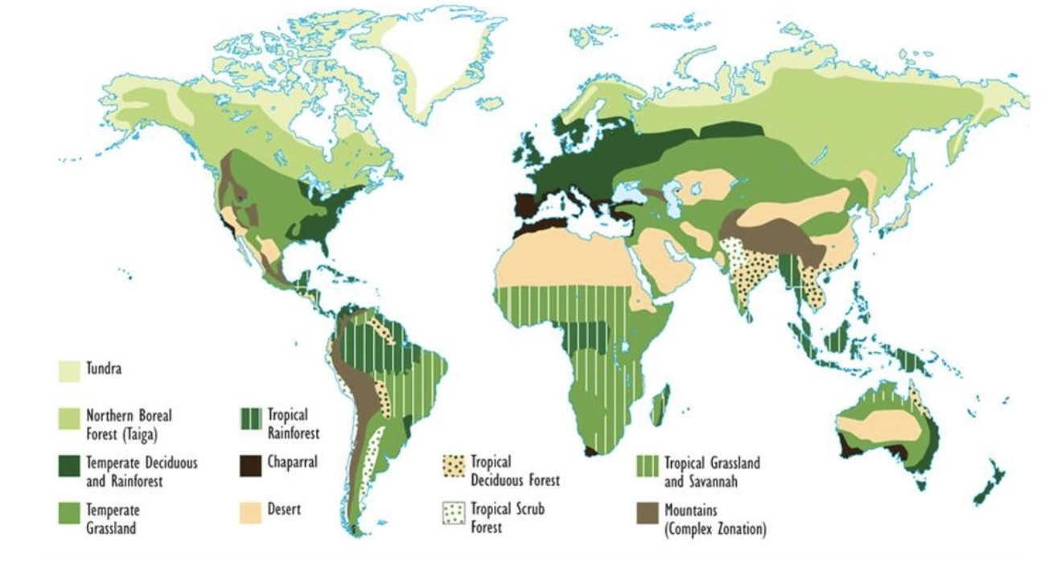

Slide 16
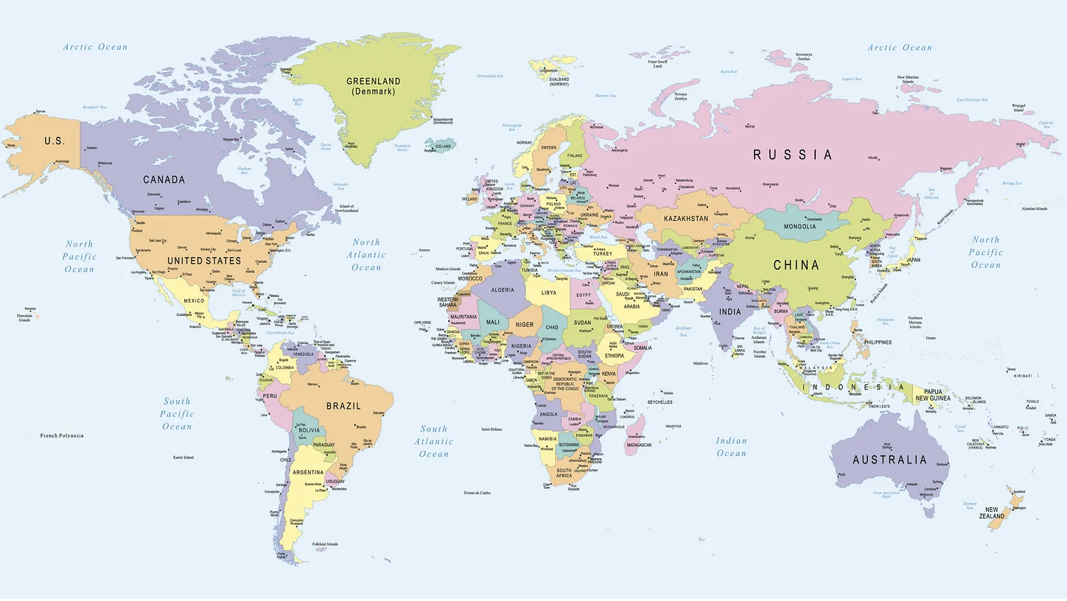

Slide 17
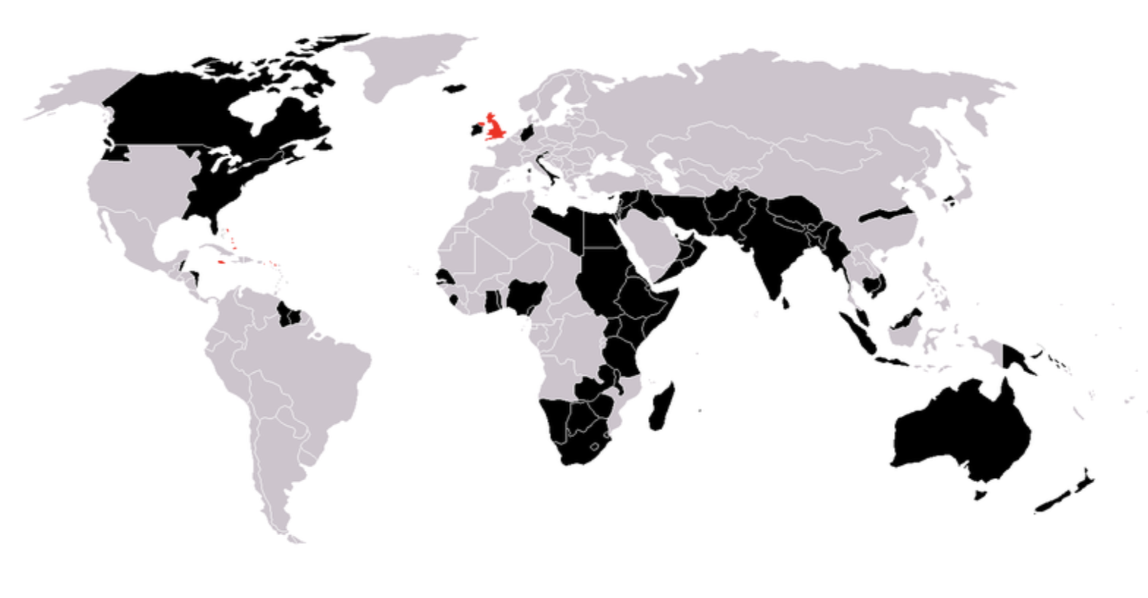

Slide 18
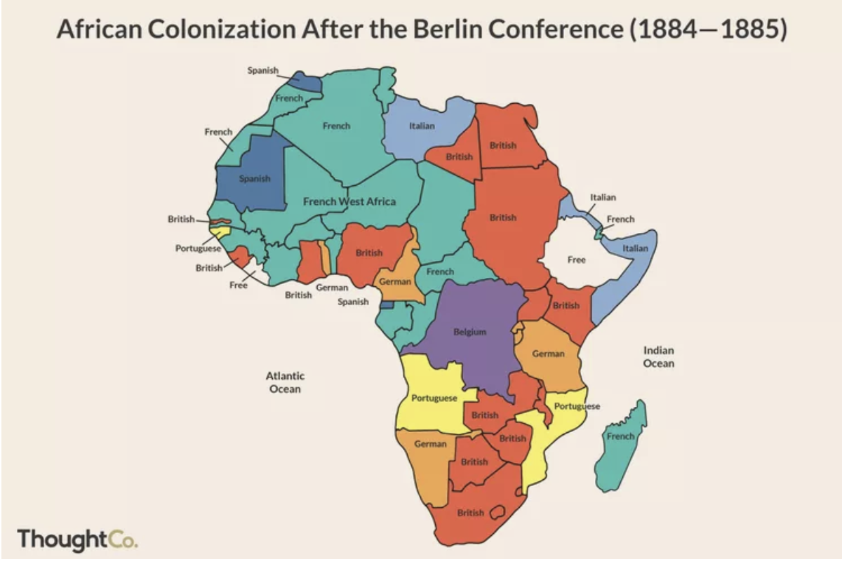

Slide 19
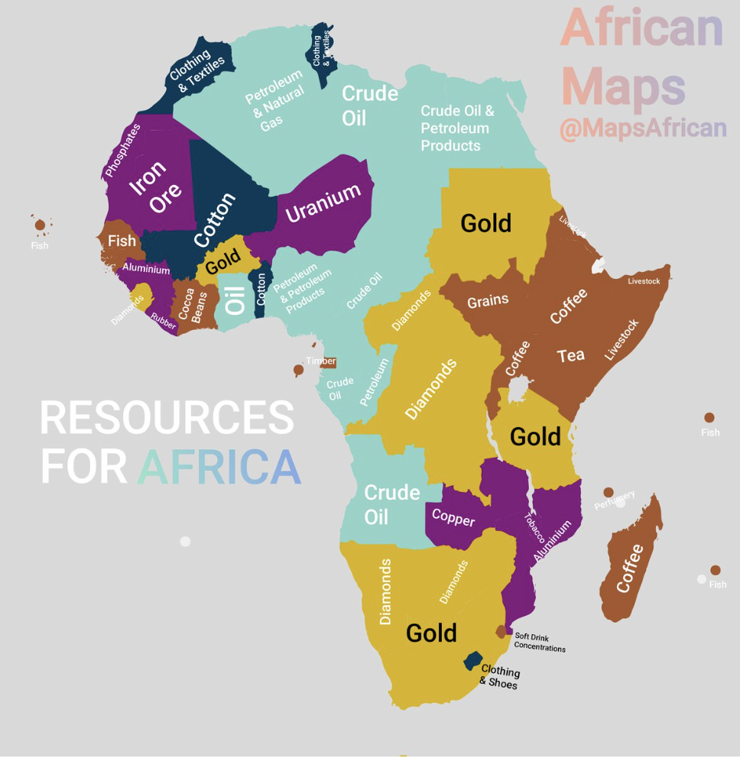

Slide 20
Climate Change

Slide 21
https://stats.oecd.org/Index.aspx?DataSetCode=CPA

Slide 24
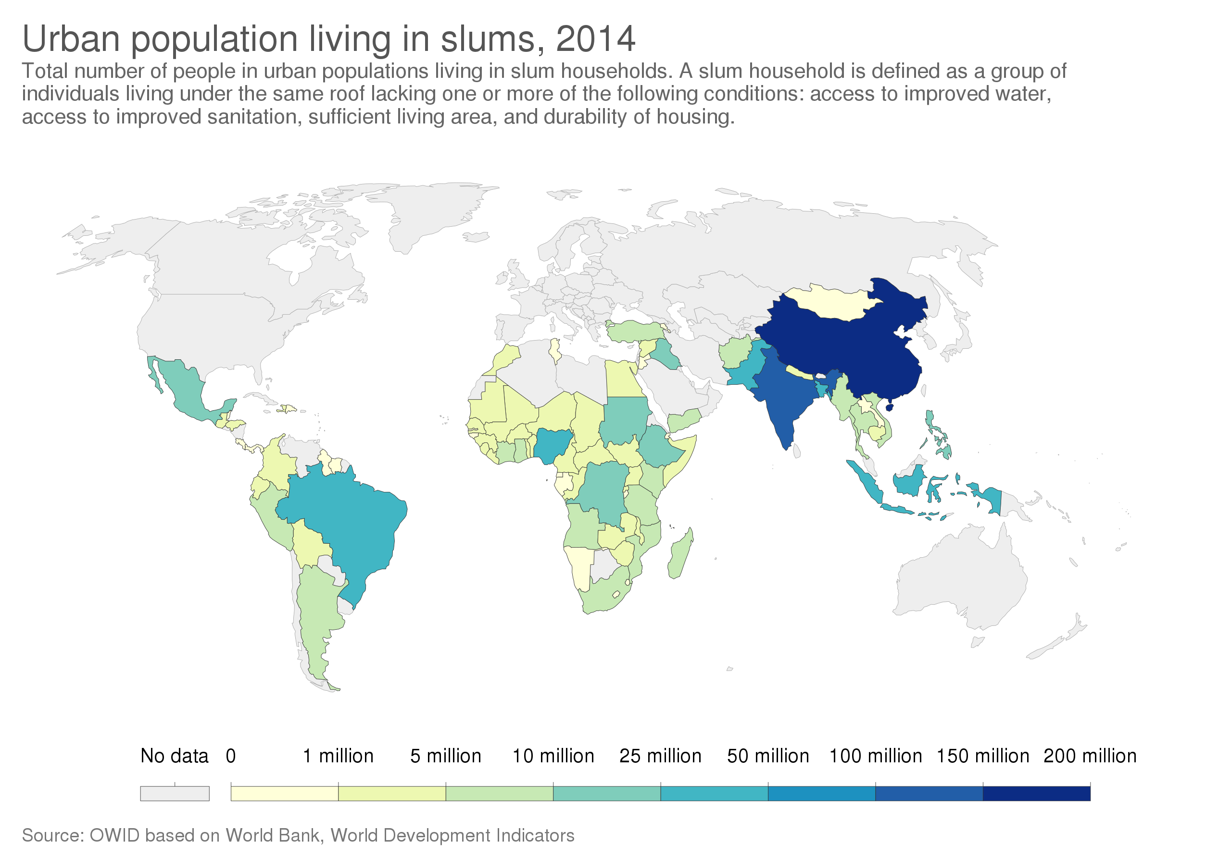
A tale of two cities

Slide 25
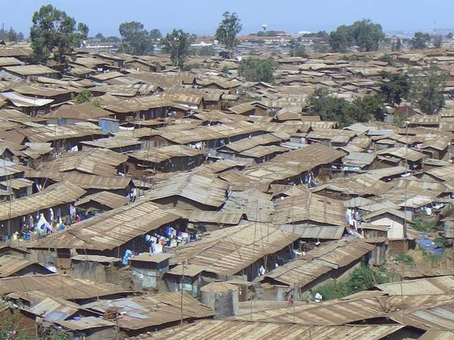
Notes:
Source: p.93 of the WWDR2 reading being summarized here

Slide 26
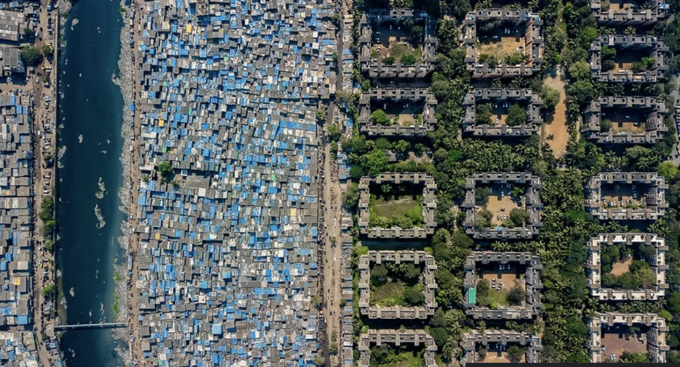

Slide 27
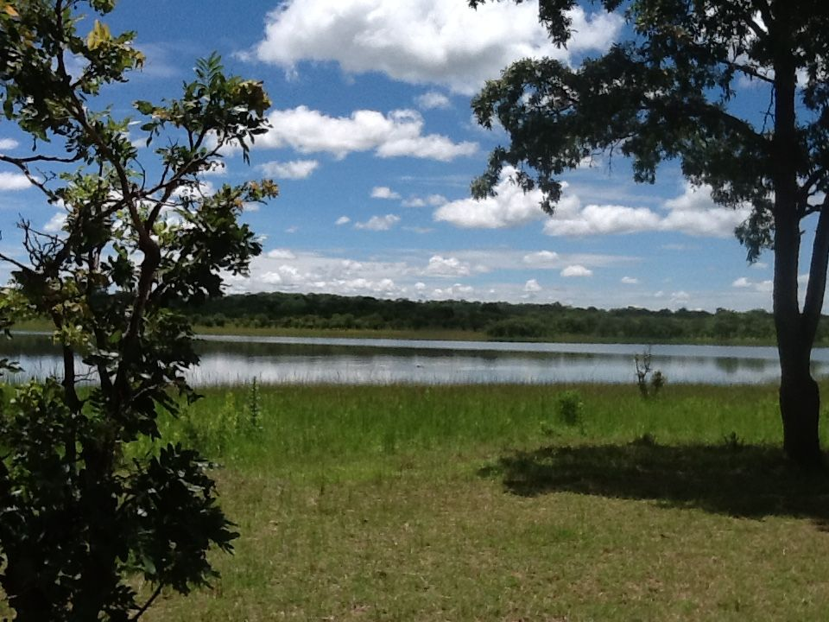
Adopting an Ecosystem Approach
An ecosystem approach broadly evaluates how people’s use of an ecosystem affects its functioning and productivity.
An ecosystem approach is an integrated approach
An ecosystem approach reorients the boundaries that traditional have defined our management of ecosystems
An ecosystem approach takes the long view
An ecosystem approach includes people
An ecosystem approach maintains the productive potential of ecosystems

Slide 28
